Slide 1






























Slide 2












Slide 3




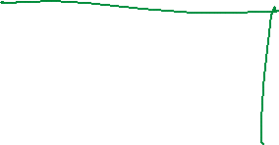






Slide 4



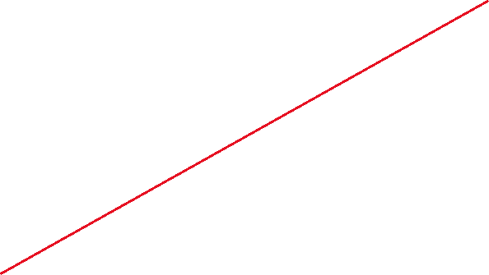














Slide 5


































Slide 6





























Slide 7


























Slide 8



































Slide 9













Slide 10


























Slide 11



































Slide 12

































Slide 13

























Slide 14
A confusion matrix is a 2X2 table that summarizes the accuracy of a classification model or diagnostic test by comparing predicted outcomes to actual outcomes. It shows where the model or test made correct predictions and where it was wrong. This summary helps you understand whether it confuses positive and negatives, helping you improve its accuracy.

Slide 15
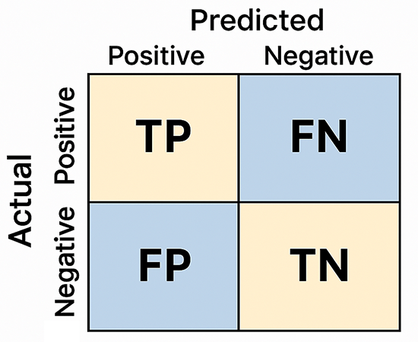














True Positive (TP): The model correctly predicts a positive case.
False Positive (FP): The model incorrectly predicts a positive case when it is actually negative.
False Negative (FN): The model incorrectly predicts a negative case when it is actually positive.
True Negative (TN): The model correctly predicts a negative case.

Slide 16















Slide 17























Slide 18















Slide 19

















































Slide 20



























Slide 21



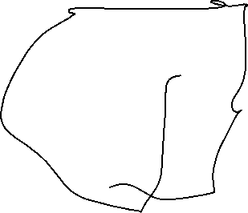














Slide 22





















Slide 23




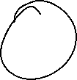














Slide 24





